Slide 1

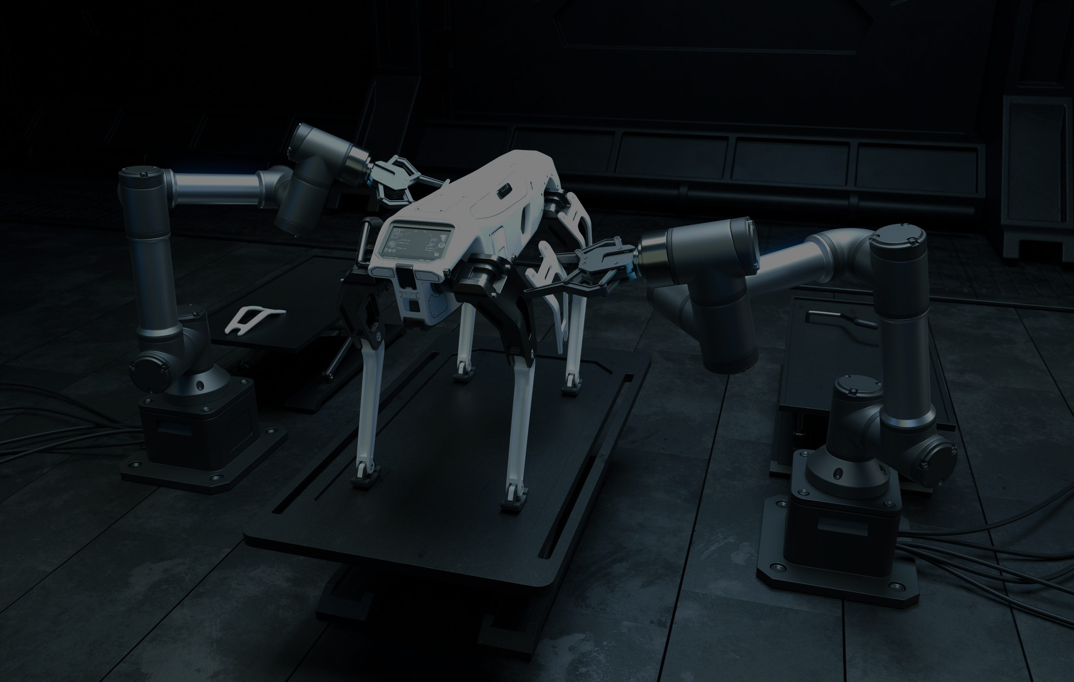
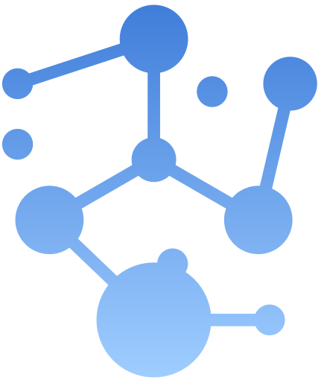


Manel
Mezni
ANALYSIS OF CARSEATS STORES USING MACHINE LEARNING
KNN Classification & K-means Clustering
next

Slide 2
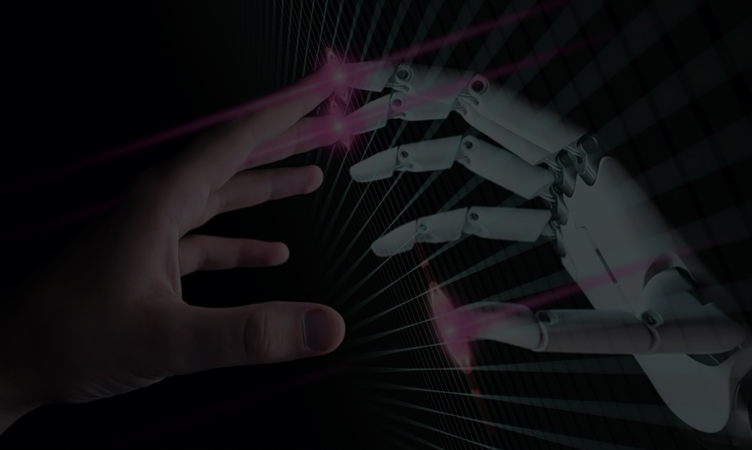
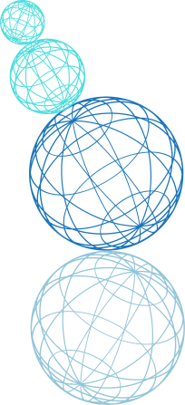
Manel
Mezni
02
ANALYSIS OF CARSEATS STORES USING MACHINE LEARNING
This presentation explores the application of maching learning techniques to analyze 400 stores from the Carseats dataset. I used two machine learning techniques: KNN for classification and K-means for clustering.
next

Slide 3
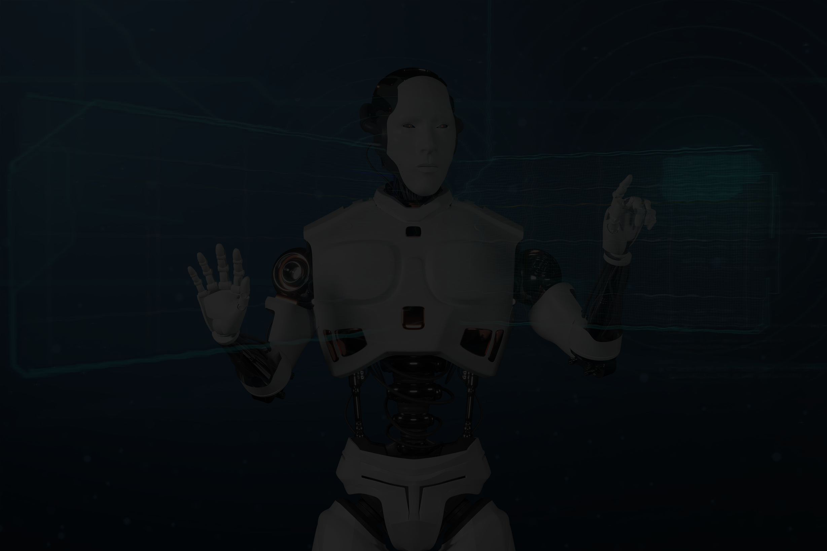

Manel
Mezni
INTRODUCTION TO MACHINE LEARNING
03
Supervised Learning: We have labeled data (like "High Sales" or "Low Sales"), and we train a model to predict these labels.
Unsupervised Learning: We have no labels; we find patterns and group similar data points together.
next

Slide 4

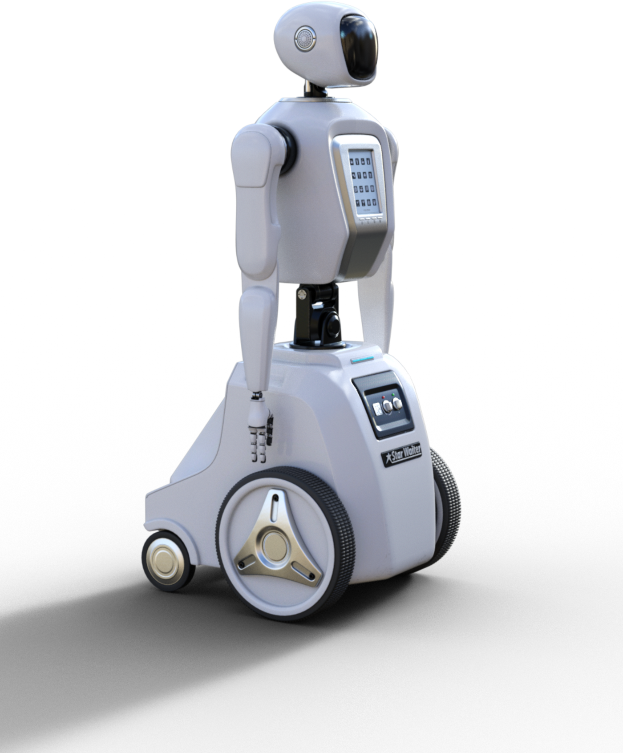
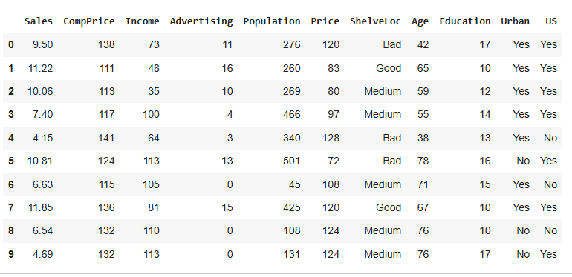
Manel
Mezni
DATASET OVERVIEW
04
The Carseats dataset consists of 400 stores and includes key variables that provide insights into store performance. Important columns include Sales, Price, Income, ShelveLoc, and Age, which together help analyze sales trends and customer demographics
next

Slide 5

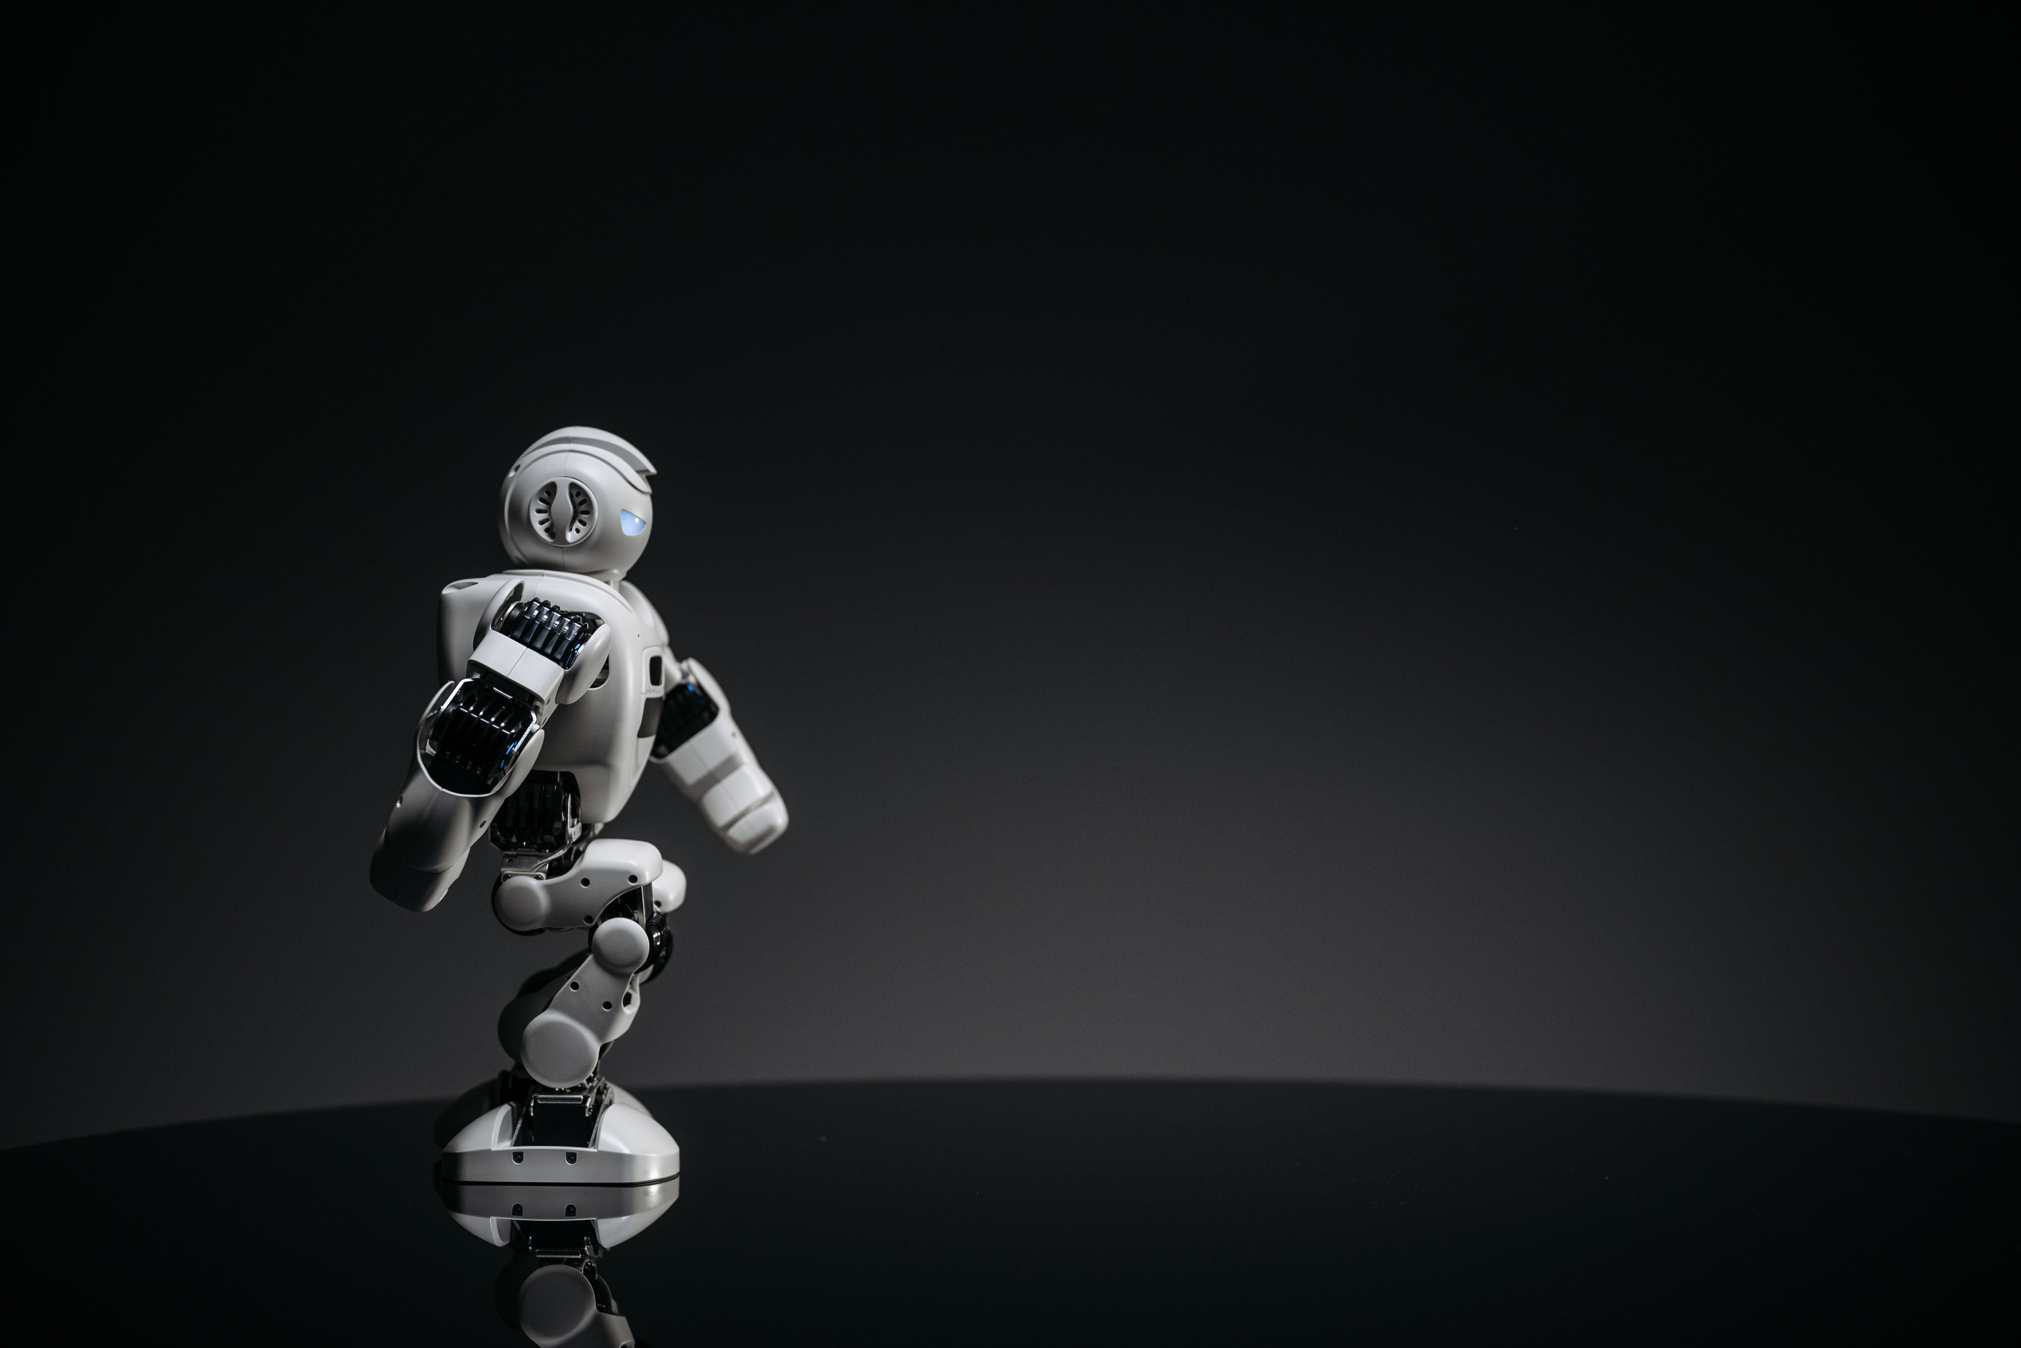

Manel
Mezni
05
KNN CLASSIFICATION
1.Created target:
To classify stores based on their sales performance, I created a binary target variable.
If a store’s sales exceeded 8, it was labeled as ‘High’ (1). Otherwise, it was labeled as ‘Low’ (0).
This clear distinction allows us to effectively train our model to predict sales categories.
next

Slide 6
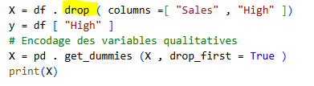
Manel
Mezni
06
KNN CLASSIFICATION
2. Prepared Feature
Next, the features used for classification were prepared. I removed the 'Sales' and 'High' columns to prevent data leakage, focusing only on the relevant features that contribute to the prediction of sales categories.
next

Slide 7
Manel
Mezni
07
KNN CLASSIFICATION
3.Encoded categorical variables (text to numbers):
Since the dataset included categorical variables, I encoded these variables to convert them from text format into numerical format. This step is crucial for KNN, as it requires all input features to be in numerical form for effective calculations.
next

Slide 8

Manel
Mezni
08
KNN CLASSIFICATION
4.Split Data
I split the dataset into training and testing subsets, allocating 70% of the data for training the model and 30% for testing its performance. This split is essential for evaluating the model's accuracy and generalizability.
next

Slide 9

Manel
Mezni
09
KNN CLASSIFICATION
5.Normalized data
To ensure that all features contribute
equally to the distance calculations in KNN,I
normalized the data.Normalization rescales
the values of the features to a common
scale, preventing any single feature from
dominating the distance computation.
next

Slide 10
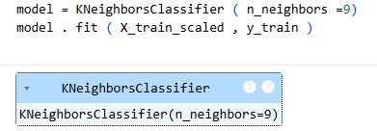
Manel
Mezni
10
KNN CLASSIFICATION
6.Trained KNN with different k values:
Finally, I trained the KNN algorithm using different values of k, which represents the number of nearest neighbors considered for classification. By experimenting with various k values, I aimed to find the optimal number that maximizes classification accuracy.
next

Slide 11
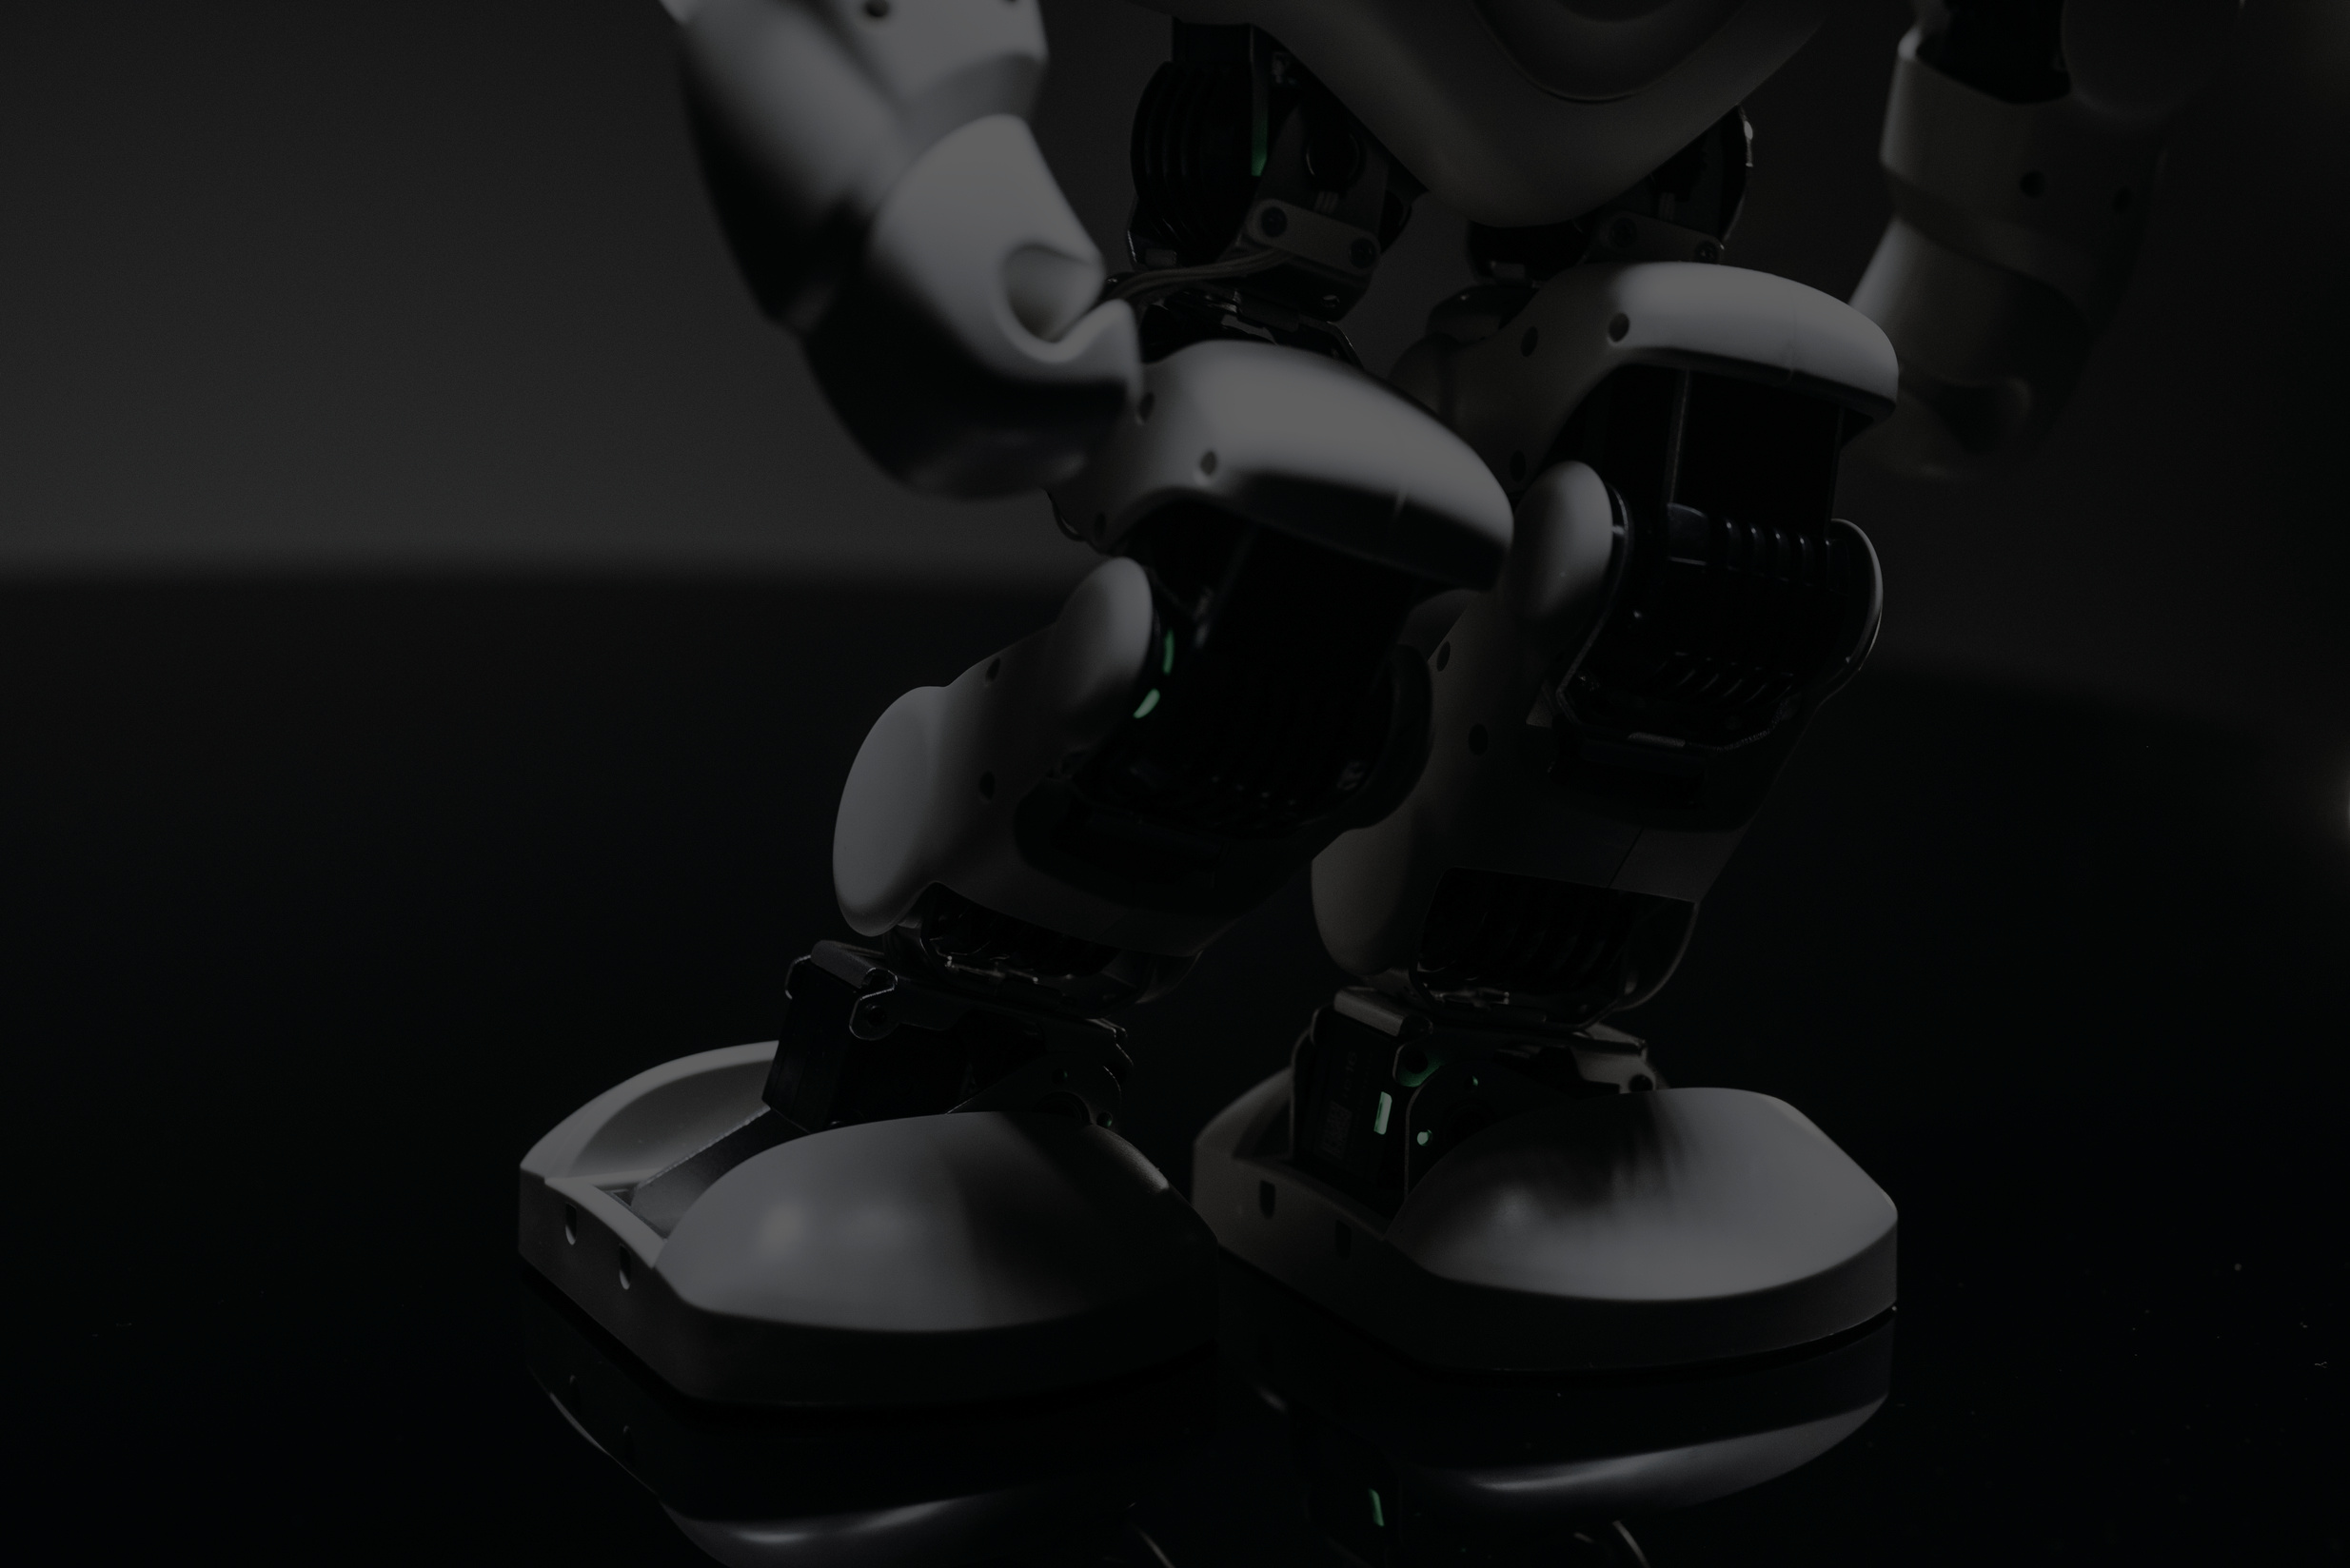
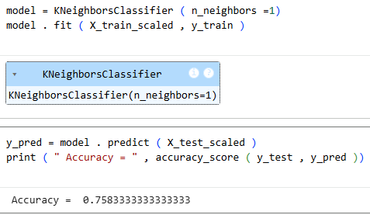
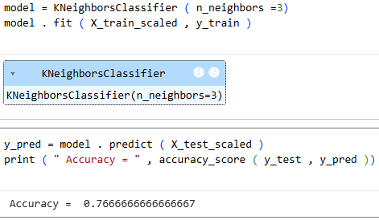
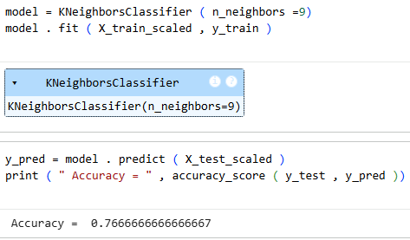
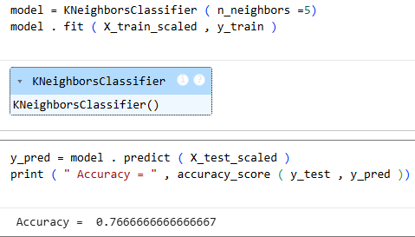
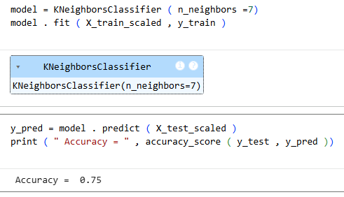
Manel
Mezni
KNN RESULTS
11
I tested different k values. k=5 gave the best accuracy of 76%. This means our model correctly predicts whether sales are high or low 76% of the time on new, unseen data.
next

Slide 12

Manel
Mezni
12
K-MEANS CLUSTERING
Used same features but no target variable:
In this step, I utilized the same features as before, but this time, there was no target variable. It's important to note that K-means clustering does not require labeled data; it works by grouping similar data points based on the features provided.
next

Slide 13
Manel
Mezni
13
K-MEANS CLUSTERING
2.Normalized data:
The data was normalized to ensure that all features contribute equally to the distance calculations in the K-means algorithm. Normalization is crucial in clustering tasks to avoid biases towards features with larger ranges.
next

Slide 14
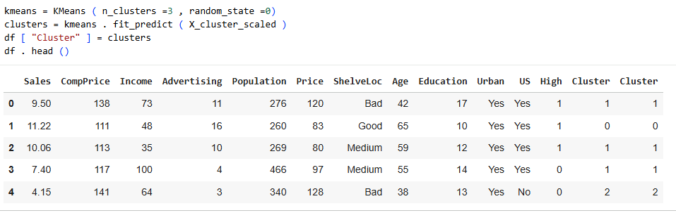
Manel
Mezni
14
K-MEANS CLUSTERING
3.Applied K-means with k=2,3,4 clusters:
I applied K-means clustering using different values of k (2 and 4) to determine the best number of clusters for the dataset. Each value of k provides different insights into how the stores can be grouped based on their characteristics.
next

Slide 15
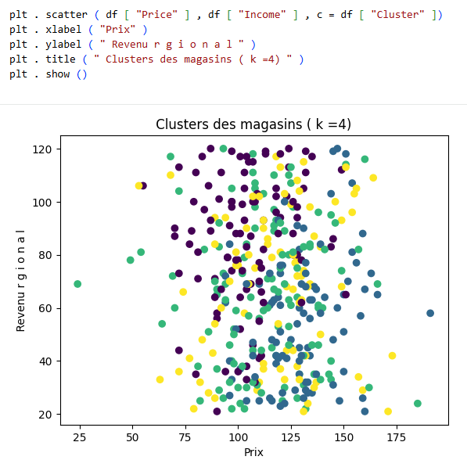
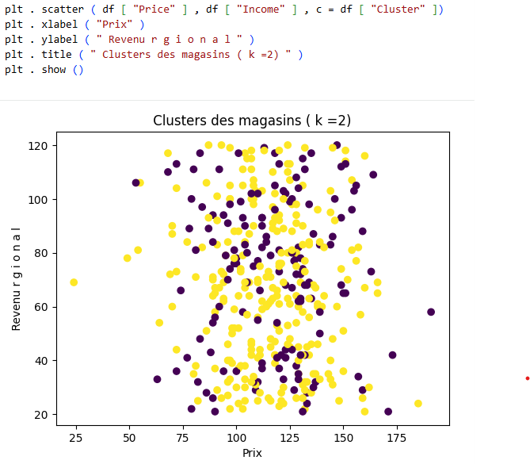
Manel
Mezni
K-MEANS CLUSTERING
15
4.Visualized results (Price vs Income):
With k=2, groups are too broad. k=4 creates some very small clusters that might not be meaningful.
next

Slide 16

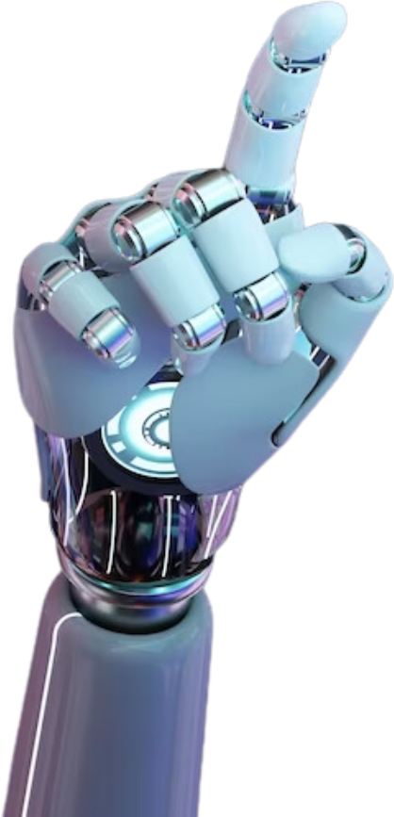
Manel
Mezni
CONCLUSION
16
1. Difference between supervised and unsupervised learning:
Supervised (KNN): We use the High column (which we created) to learn.
Unsupervised (K-means): We ignore High, we just group stores by similarity.
2. For KNN
a) What is the best k tested?
I tested k = 1, 3, 5, 7, 9. The best score was with k = 5, which gave an accuracy of 76% on the test data.
b) Is the model good?
An accuracy of 76% means it correctly predicts 3 out of 4 sales. This is acceptable but could be improved.
next

Slide 17
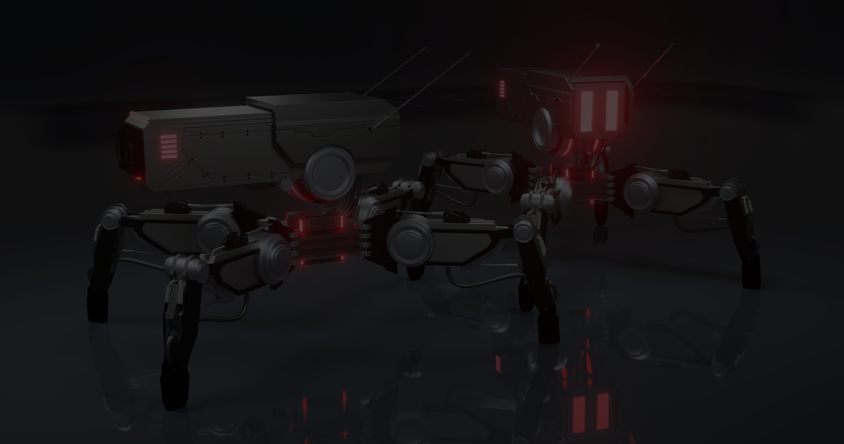

Manel
Mezni
CONCLUSION
17
3. For K-means
Are the clusters coherent?
1The points are heavily mixed
In both graphs (k=2 and k=4), the colors representing clusters are spread everywhere with no clear separation.
No, the clusters are not very coherent.
these two variables alone may not be enough,
b) What other attributes could better separate the groups?
1. Advertising: Marketing budgets strongly influence sales
2. Population: Population density around the store
4. What type of business could use this analysis?
A furniture/home decor chain (like Carseats) for:
Predicting performance of new locations (KNN)
Adapting promotions by store group (K-means)
next

Slide 18


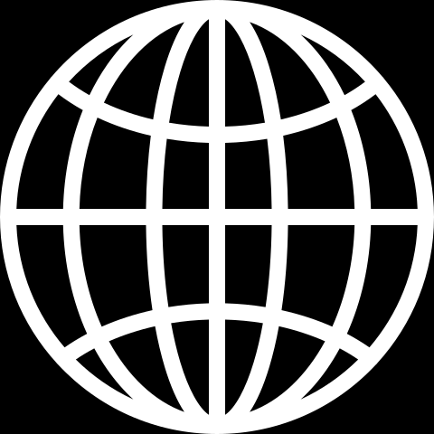
Manel
mezni
18
THANK YOU!
manelmezni688@gmail.com
www.linkedin.com/in/manelmezni

